Slide 1


Slide 2
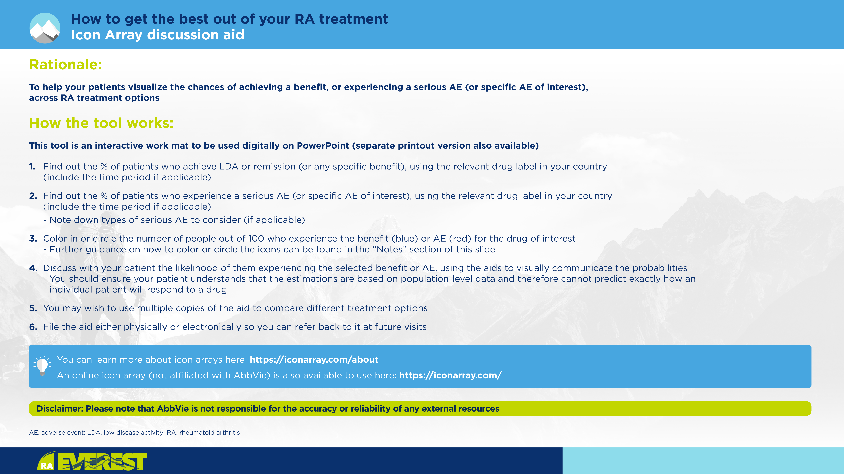
Notes:
To color in the icons:
1) Select the relevant number of icons
2) Click on the "Graphics Format" tab
3) Select "Graphics Fill"
4) Choose the appropriate color (blue for benefit; red for adverse event)
Alternatively, to circle the icons:
1) Click on the "Insert" tab
2) Select "Shapes"
3) Choose the freeform line (last icon in "Lines")
4) Circle around the icons

Slide 3




